Slide 1

Trauma-Informed Practice:
Procedural Fairness, Criminal Responsibility and Sustainable Legal Practice
Dr Felicity Gerry KC
Notes:
Argument: Trauma-informed practice is not only about supporting victims. It is also about strengthening the integrity of the criminal justice system through procedural fairness, assessments of criminal responsibility, and sustainable legal practice.
Define trauma – Roslyn Carnes work on ‘Raising the Bar: A Case for Trauma Informed Lawyers’. Uses the definition of trauma from Atkinson (2002) ‘trauma is therefore an event or process which overwhelms the individual, family or community and the ability to cope in the mind, body, soul (and) spirit’
Roslyn Carnes, Raising the Bar: A Case for Trauma Informed Lawyers (Loddon Campaspe Community Legal Centre, 2017).
Felicity Gerry, 'Why Being Trauma Informed Is an Issue for Court Integrity' (Web Page, 14 July 2022) Legalwise Seminars.
Felicity Gerry, 'Trauma-informed Courts (Pt 1)' (2021) 171(7919) New Law Journal 16.
Felicity Gerry, 'Trauma-informed Courts (Pt 2)' (2021) 171(7922) New Law Journal 16.
Image credit: https://www.vecteezy.com/photo/58476007-a-person-s-hands-gently-hold-a-golden-scale-symbolizing-justice-and-balance

Slide 2
Why Trauma-Informed Practice Matters
Courts deal with vulnerable people and people at their most vulnerable
Trauma-informed practice is an issue of:
Procedural Fairness
Legitimacy
Court Integrity
Public Confidence
Notes:
Landmarks of procedural fairness: voice, neutrality, respectful treatment, trustworthy authorities. Also identified five additional elements: accountability, availability of amenities, access to information, inclusivity, understanding.
Procedural fairness can impact on trust, confidence and legitimacy.
Peter Jamadar and Elron Elahie, Proceeding Fairly: Report on the Extent to Which Elements of Procedural Fairness Exist in the Court Systems of the Judiciary of the Republic of Trinidad and Tobago (Judicial Education Institute of Trinidad and Tobago, 2018)

Slide 3
Trauma and Participation
Court processes may exacerbate trauma
Trauma may affect recall, coherence, consistency, credibility and/or emotional presentation
Challenges separating trauma from evidential reliability
Cultural and linguistic barriers
Notes:
Louise Ellison and Vanessa E Munro, 'Taking Trauma Seriously: Critical Reflections on the Criminal Justice Process' (2017) 21(3) International Journal of Evidence and Proof 183.

Slide 4

Victorian Context
Ensuring that all people can participate in the criminal justice process gives effect to the right to a fair trial
  Charter of Human Rights and Responsibilities Act 2006 (Vic) s 24
MARAM Framework and Foundation Knowledge Guide
Notes:
Trauma-informed practice is embedded in multiple Victorian laws:
Victims' Charter Act 2006 (Vic)
Criminal Procedure Act 2009 (Vic)
Charter of Human Rights and Responsibilities Act 2006 (Vic)
Family Safety Victoria, MARAM Practice Guides: Foundation Knowledge Guide (Victorian Government, 2021) https://www.vic.gov.au/maram-practice-guides-foundation-knowledge-guide.
This presentation uses trauma-informed as the overarching term, acknowledging that Victoria's family violence system increasingly refers to trauma- and violence-informed practice to emphasise the structural and ongoing nature of violence, particularly in family violence contexts.
MARAM Framework underpins trauma-informed responses across Victoria's justice systems following the Royal Commission into Family Violence.
Royal Commission into Family Violence, Report and Recommendations (Parliament of Victoria, 2016).
Victorian Law Reform Commission recommends reforms designed to reduce trauma while preserving procedural fairness, including:
improving the experiences of victim-survivors throughout the justice process;
expanding trauma-informed practices across the justice system;
improving witness support and communication;
increasing judicial and practitioner education; and
recognising that justice responses should minimise unnecessary retraumatisation while maintaining fair trial rights.
Victorian Law Reform Commission, Improving the Justice System Response to Sexual Offences: Report (Report, 2021) https://www.lawreform.vic.gov.au/wp-content/uploads/2023/08/VLRC_Improving_Justice_System_Response_to_Sex_Offences_Report_web.pdf.
Victorian courts are responsible for administering justice fairly, transparently, impartially and with integrity, while pursuing accessibility and excellence in court administration.
Court Services Victoria, Court Services Victoria Strategic Plan 2020–2025 (Strategic Plan, November 2020) https://courts.vic.gov.au/publications/court-services-victoria-strategic-plan-2020-2025.
Image credit: https://www.supremecourt.vic.gov.au/about-the-court/our-history

Slide 5
Trauma-Informed Courts
Trauma-informed justice is a whole-of-court responsibility
Move beyond victims and includes accused, witnesses, police investigators, prosecutors, lawyers, judges, jurors, court staff
The court becomes trauma-informed: safety, participation, respectful communication.
Notes:
Trauma-informed courts draw on, but are distinct from, therapeutic jurisprudence.
For example, Bruce J Winick and David B Wexler (eds), Judging in a Therapeutic Key: Therapeutic Jurisprudence and the Courts (Carolina Academic Press, 2003)

Slide 6
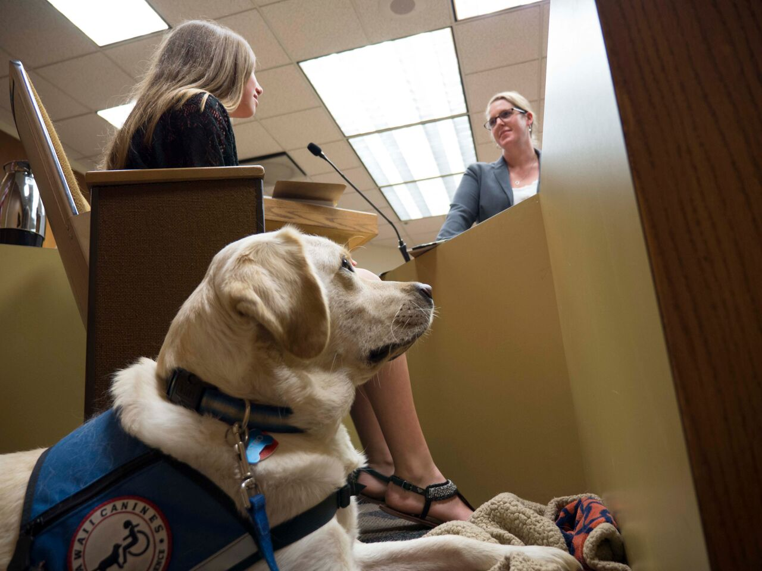
Trauma-Informed Adjustments
  Communication
    Intermediaries
    Judicial directions / ground rules
    Witness preparation
    Trauma-sensitive questioning (e.g. PEACE)
  Environment
    Remote evidence
    Support dogs
    Scheduling
    Waiting times
Notes:
Responsive rather than prescriptive; individualised rather than standardised
Victorian Intermediary Program
Department of Justice and Community Safety (Vic), Intermediary Program (Web Page) https://www.justice.vic.gov.au/justice-system/courts-and-tribunals/intermediary-program
Criminal Procedure Act 2009 (Vic). (Part 8.2 outlines intermediaries scheme)
Court Dogs Victoria Incorporated, Court Dogs Victoria (Web Page) https://www.courtdogsvictoria.org.au
Tiffani J Howell et al, 'Integrating Facility Dogs into Legal Contexts for Survivors of Sexual and Family Violence: Opportunities and Challenges' (2021) 34(6) Anthrozoös 863.
Image credit: https://courthousedogs.org/

Slide 7
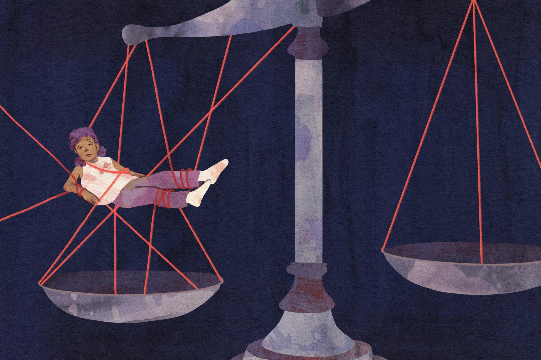
Understanding Victim-Survivor Defendants
Many defendants are also victim-survivors
  Trafficking victims prosecuted for offending
  Forced criminality / duress
  Domestic and family violence
  Coercive control
Trauma influences agency
Notes:
Victim and offender are not mutually exclusive legal identities
Coercive control as a pattern of ongoing domination rather than isolated incidents;
Profound impacts on victim-survivors' mental health, wellbeing and decision-making;
The need to understand offending behaviour within the broader context of coercive control.
Jasmine B MacDonald et al, What the Research Evidence Tells Us About Coercive Control Victimisation (Policy and Practice Paper, Child Family Community Australia, Australian Institute of Family Studies, February 2024) https://aifs.gov.au/sites/default/files/2024-02/2311_CFCA_Coercive-control-victimisation.pdf
Image Credit: https://thewalrus.ca/what-happens-after-young-victims-testify/

Slide 8
Trauma and Criminal Responsibility
Trauma raises questions about:
  Intent
  Voluntariness
  Agency and autonomy
  Capacity
  Culpability
Trauma-induced automatism, dissociation
  R v Falconer (1990) 171 CLR 30
Notes:
Questions:
1. Intent: Did the accused possess the required mental state / mens rea?
2. Voluntariness: Were the accused’s actions truly voluntary?
3. Agency and autonomy: To what extent was decision-making compromised by coercion, abuse or exploitation?
4. Capacity: Did trauma-related conditions (like disassociation) affect the person’s ability to exercise conscious control?
5. Culpability: Should trauma influence assessments of blameworthiness, even when criminal responsibility is established?
Trauma is relevant to consider at various stages: voluntariness, intention, available defences, duress, sentencing, mitigating factors and rehabilitation
Bernadette McSherry and Michael Cook, ‘Seizures, Postictal States and Criminal Responsibility’ (2022) 29(3) Journal of Law and Medicine 707.

Slide 9
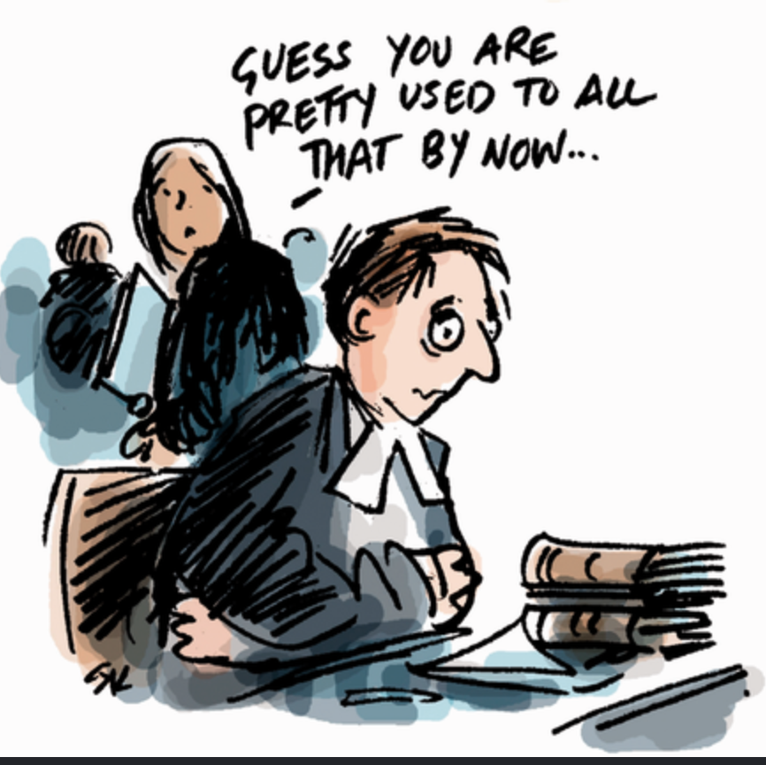
The Trauma-Informed Lawyer
Lawyers are rarely trained to deal with trauma
  Vicarious trauma / secondary stress
  Repeated exposure to traumatic material
  Compassion fatigue
  Burnout
Notes:
Image Credit: https://sites.bu.edu/daniellerousseau/2025/02/25/vicarious-trauma-in-the-legal-system/

Slide 10
Trauma-Informed Legal Practice
System reform is required
Trauma-informed legal education
Driven by circumstances and individual needs:
  Manageable workloads
  Schedule choices
  Recognising trauma exposure
  Reflective practice
  Peer support
  Feedback and debriefing
Notes:
Helgi Maki et al (eds), Trauma-Informed Law: A Primer for Practicing Lawyers and a Pathway for Resilience and Healing (American Bar Association, 2023). https://www.traumainformedlaw.org/trauma-informed-law-book
Law Institute of Victoria, Wellbeing Resources (Web Page) https://www.liv.asn.au/wellbeing
Victorian Bar, Health and Wellbeing at the Victorian Bar (Web Page) https://www.vicbar.com.au/Web/Web/Contents/Community/Health-and-Wellbeing/Health_and_Wellbeing.aspx
Department of Families, Fairness and Housing (Vic), Family Violence Workforce Wellbeing Guide (Victorian Government, 2021). https://www.vic.gov.au/family-violence-workforce-wellbeing-guide

Slide 11
Strengthening Criminal Justice Through Trauma-Informed Practice
Enhances participation and strengthens procedural fairness
Improves assessment of criminal responsibility
Supports sustainable legal practice

Slide 12
Trauma-Informed Practice:
Procedural Fairness, Criminal Responsibility and Sustainable Legal Practice
Dr Felicity Gerry KC
Notes:
Conclude with some questions:
If trauma can fundamentally affect participation, communication and, in some cases, agency or voluntariness, what does truly trauma-informed criminal practice require of us as lawyers?
More specific probes:
How might trauma affect participation? Do you have any examples from their practice or experience?
What types of court adjustments are / have been required?
What types of communication assistance are / have been needed?
Are you aware of any examples or cases where trauma raises issues of agency or voluntariness?
What types of expert evidence are / have been required?
What support might / do you need as lawyers?
Bibliography
Carnes, Roslyn, Raising the Bar: A Case for Trauma Informed Lawyers (Loddon Campaspe Community Legal Centre, 2017).
Court Dogs Victoria Incorporated, Court Dogs Victoria (Web Page) https://www.courtdogsvictoria.org.au.
Court Services Victoria, Court Services Victoria Strategic Plan 2020–2025 (Strategic Plan, November 2020).
Department of Families, Fairness and Housing (Vic), Family Violence Workforce Wellbeing Guide (Victorian Government, 2021).
Department of Justice and Community Safety (Vic), Intermediary Program (Web Page) https://www.justice.vic.gov.au/justice-system/courts-and-tribunals/intermediary-program.
Ellison, Louise and Vanessa E Munro, 'Taking Trauma Seriously: Critical Reflections on the Criminal Justice Process' (2017) 21(3) International Journal of Evidence and Proof 183.
Family Safety Victoria, MARAM Practice Guides: Foundation Knowledge Guide (Victorian Government, 2021).
Gerry, Felicity, 'Trauma-informed Courts (Pt 1)' (2021) 171(7919) New Law Journal 16.
Gerry, Felicity, 'Trauma-informed Courts (Pt 2)' (2021) 171(7922) New Law Journal 16.
Gerry, Felicity, 'Why Being Trauma Informed Is an Issue for Court Integrity' (Web Page, 14 July 2022) Legalwise Seminars.
Howell, Tiffani J et al, 'Integrating Facility Dogs into Legal Contexts for Survivors of Sexual and Family Violence: Opportunities and Challenges' (2021) 34(6) Anthrozoös 863.
Jamadar, Peter and Elron Elahie, Proceeding Fairly: Report on the Extent to Which Elements of Procedural Fairness Exist in the Court Systems of the Judiciary of the Republic of Trinidad and Tobago (Judicial Education Institute of Trinidad and Tobago, 2018).
Law Institute of Victoria, Wellbeing Resources (Web Page) https://www.liv.asn.au/wellbeing.
MacDonald, Jasmine B et al, What the Research Evidence Tells Us About Coercive Control Victimisation (Policy and Practice Paper, Child Family Community Australia, Australian Institute of Family Studies, February 2024).
Maki, Helgi et al (eds), Trauma-Informed Law: A Primer for Practicing Lawyers and a Pathway for Resilience and Healing (American Bar Association, 2023).
McSherry, Bernadette and Michael Cook, 'Seizures, Postictal States and Criminal Responsibility' (2022) 29(3) Journal of Law and Medicine 707.
Royal Commission into Family Violence, Report and Recommendations (Parliament of Victoria, 2016).
Victorian Bar, Health and Wellbeing at the Victorian Bar (Web Page) https://www.vicbar.com.au/Web/Web/Contents/Community/Health-and-Wellbeing/Health_and_Wellbeing.aspx.
Victorian Law Reform Commission, Improving the Justice System Response to Sexual Offences: Report (Report, 2021).
Winick, Bruce J and David B Wexler (eds), Judging in a Therapeutic Key: Therapeutic Jurisprudence and the Courts (Carolina Academic Press, 2003).
Laws
Charter of Human Rights and Responsibilities Act 2006 (Vic).
Criminal Procedure Act 2009 (Vic).
Victims' Charter Act 2006 (Vic).
Case
R v Falconer (1990) 171 CLR 30.

